Slide 1

BUILDING SUSTAINABLE ELECTRICITY TOGETHER – POWER OF COMMUNITY

Slide 2
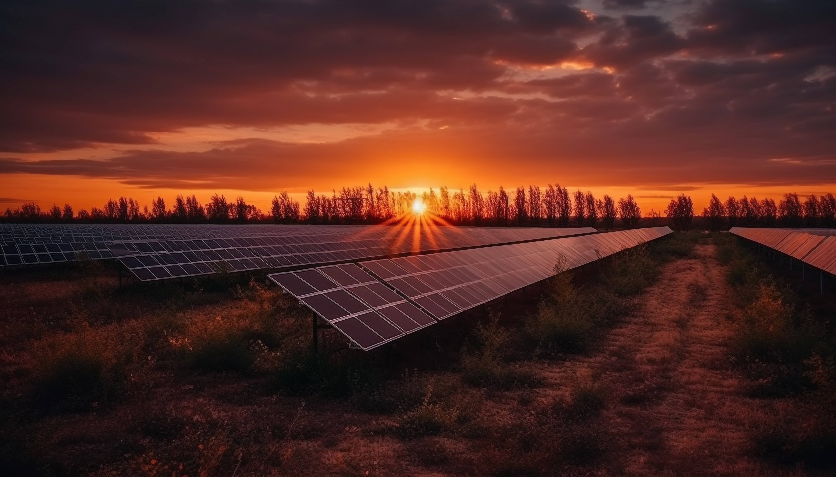
BUILDING SUSTAINABLE ELECTRICITY TOGETHER – POWER OF COMMUNITY

Slide 3

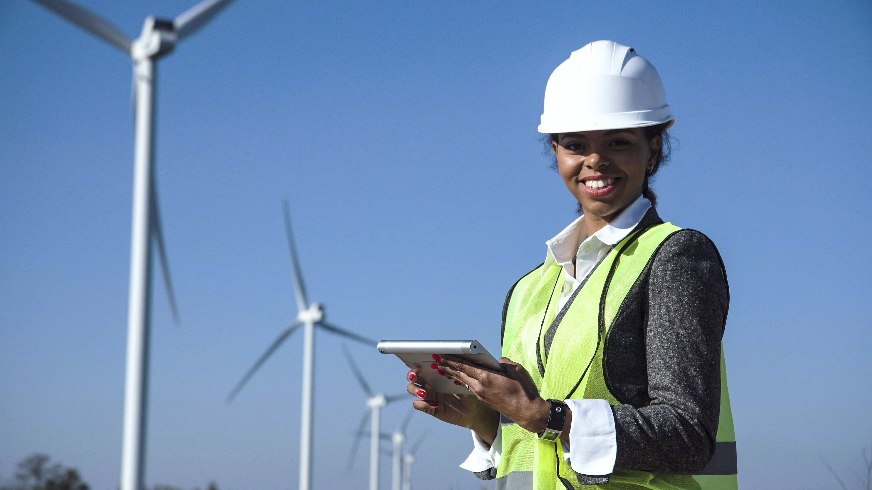
BUILDING SUSTAINABLE ELECTRICITY TOGETHER – POWER OF COMMUNITY

