Slide 1
WELCOME
to the
SAASTA
AstroQuiz 2018
NATIONAL FINALS

Slide 2
RULES OF THE QUIZ
The audience must be silent throughout the quiz and NOT whisper to anyone.
No resource material can be taken into the quiz venue.
Teams have up to 1 minute to discuss each answer and must reveal their answers immediately when the signal is given that the time is up.
The scores will be calculated and given after THE FIRST ten questions ONLY and overall winners will be announced at the Awards function in the evening.
The audience will get a chance to win prizes!
A tie-break will be settled on a “sudden death” basis, involving tied teams only (i.e. as soon as a team falls behind on correct answers, it is knocked out).

Slide 3
QUESTION 1
The longest lunar eclipse of the 21st century took place on this date.
        27 June 2018
        31 July 2018
        27 July 2018
        31 June 2018

Slide 4
QUESTION 2
During what time of the day did this eclipse occur?
        Day
        Night
        Morning
        Noon

Slide 5
QUESTION 3
During that eclipse, what was the colour of the Moon?
      Very dark
      Blood red
      Blue
      Black

Slide 6
QUESTION 4
During this eclipse period, there was a certain planet that was seen close to the Moon. Which planet was that?
        Earth
        Venus
        Mars
        Saturn

Slide 7
QUESTION 5
Because this planet was close to the Moon in the sky, its purpose was ____
    To give the Moon the blood red colour
    To keep the Moon in its place during the eclipse
    To support the Moon, the Earth and the Sun during the eclipse
    None of the above

Slide 8
QUESTION 6
The diameter of the Moon is 3 475 km. If a soccer field is 100 m long, how many soccer fields will fit in the Moon’s diameter?
          3 475 000
          347 500
          34 750
          3 475

Slide 9
QUESTION 7
The Moon shows the same side to Earth during its orbit.
      True
      False

Slide 10
QUESTION 8
More than 100 spacecraft have been launched to explore the Moon.
It’s the only celestial body beyond Earth visited by human beings.
The moon is the brightest and largest feature in the night sky.
The Moon is a rocky, solid-surface body with much of its surface cratered and pitted from impacts.
Which of the above is true about the Moon?
A. All 4 facts; B. I & IV; C. II & III; D. II, III & IV

Slide 11
QUESTION 9
In which year did South Africa win the bid to host the Square Kilometre Array (SKA)?
        2010
        2011
        2012
        2013

Slide 12
QUESTION 10
The Karoo Array Telescope 7(KAT-7) is a forerunner of the MeerKAT which is the forerunner of the eventual SKA.
      True
      False

Slide 13
QUESTION 11
An Observatory is a______
a group of telescopes
place/structure with equipment to observe celestial events/bodies
a telescope used to observe planets, stars and other celestial bodies
an act of observing

Slide 14
QUESTION 12
The largest verified and one of the oldest impact crater on Earth is the ____ crater.
      Tswaing
      Kalkkop
      Vredefort
      Morokweng

Slide 15
QUESTION 13
This crater is situated in the ________
    Free State province of South Africa
    North West province of South Africa
    United States of America
    Northern Cape province of South Africa

Slide 16
QUESTION 14
The nearest planet to the Sun with more than one moon is ______
        Mercury
        Mars
        Saturn
        Jupiter

Slide 17
QUESTION 15
How many moons does this planet in Question 14 above have?
      2
      16
      23
      64

Slide 18
QUESTION 16
The nearest planet to the Sun with rings is_____
        Neptune
        Mars
        Jupiter
        Saturn

Slide 19
QUESTION 17
The brightest star in the sky, Sirius, is/was____
    Closest to the Earth
    Whiter and hotter than the Sun
    Blue and cold
    Discovered by Robert Innes in 1915

Slide 20
QUESTION 18
Which of the following objects is the smallest of them all?
      Star
      Galaxy
      Solar system
      Planet

Slide 21
QUESTION 19
Tswaing, Vredefort, _____ and ____ are impact craters.
  Mankweng and Vredekop
  Morokweng and Kalkkop
  Morokweng and Mankweng
  Mankweng and Kalkkop

Slide 22
QUESTION 20
The impact craters mentioned in Question 19 above are found in ____ provinces respectively.
Gauteng; Northern Cape; Free State and Western Cape
Gauteng; Free State; Eastern Cape and North West
North West; Free State; North West and Eastern Cape
Gauteng; Free State; North West and Eastern Cape

Slide 23
QUESTION 21
Which planet has the longest day of all the planets in the solar system?
        Saturn
        Mercury
        Venus
        Jupiter

Slide 24
QUESTION 22
The most abundant metal element in the Earth is _____
        Iron
        Oxygen
        Nitrogen
        Gold

Slide 25
QUESTION 23
The most abundant gas in Earth’s atmosphere is _____
        Iron
        Oxygen
        Nitrogen
        Gold

Slide 26
PLEASE REFER TO THE PICTURE PROVIDED TO ANSWER
QUESTIONS 24 - 30

Slide 27
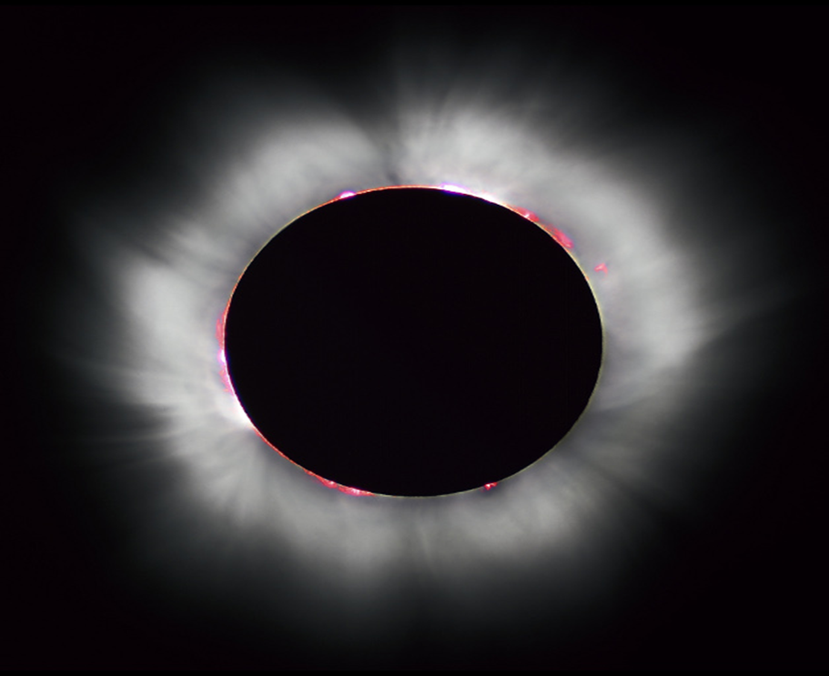
PICTURE A

Slide 28
QUESTION 24
What event is represented by picture A provided?
      Super moon
      Eclipse
      Ellipse
      Burning Sun

Slide 29
QUESTION 25
The diameters of the Earth and the Moon are approximately 12 756 and 3 475 km respectively. How many times bigger is the Earth than the Moon?
          0.27
          9 281
          3.76
          3.67

Slide 30
QUESTION 26
During what time of the day can we see/view this event?
      Day
      Night
      Only at sunset
      Midnight

Slide 31
QUESTION 27
During this event ________.
the Moon moves in its orbit between Earth and the Sun
the Earth moves in its orbit between Moon and the Sun
the Sun moves in its orbit between Earth and the Moon
the Moon moves in its orbit between Mars and the Sun

Slide 32
QUESTION 28
This event happens only during ______
      Full Moon
      New Moon
      First Quarter
      Last Quarter

Slide 33
QUESTION 29
If the Moon was moving in the same plane as Earth and Sun, then such an event would take place about once _____
      Day
      Month
      Year
      Century

Slide 34
QUESTION 30
If the Earth has a diameter of 12 756 kilometres, what will its circumference (C) be in kilometres?
NB: C = 2 π r , pi (π) = 3.14; r is radius.
          4,0054 x 10⁴
          4,0054 x 10⁵
          4,0054 x 10⁶
          40,0054 x 10⁷

Slide 35
THANK YOU

Slide 36
SUDDEN DEATH
TIE BREAKERS

Slide 37
PLEASE REMEMBER:
The first team to get the correct answer is the winner!
ALL THE BEST!

Slide 38
QUESTION 1
The diameters of Sun, Jupiter and Earth are approximately 1 391 000, 142 984 and 12 756 km respectively. How many times bigger is the Sun than Jupiter and Earth respectively?
          9.73 and 109
          1 248 016 and 1 378 244
          0.10 and 0,01

Slide 39
QUESTION 2
The brightest star in the sky, Sirius, is/was____
    Closest to the Earth
    Whiter and hotter than the Sun
    Blue and cold
    Discovered by Robert Innes in 1915

Slide 40
QUESTION 3
Which of the following is the
most accurate statement about the seasons?
  Seasons occur because the Sun goes around the Earth and the Moon around the Earth
  Seasons occur because the Earth goes around the Sun
  Seasons occur because the Earth goes around the Sun and its axis is tilted at 23.5⁰ to the plane of its orbit
  Seasons occur because the Earth’s orbit brings it nearer and further away from the Sun

Slide 41
QUESTION 4
Which one of the following is true?
A galaxy is made of a few collection of stars held together by gravity
None of the stars in a galaxy have common gravity
Galaxies contain stars only
A galaxy is a collection of many stars, gas and dust which are held together by gravity

Slide 42
QUESTION 5
Ordered by decrease in diameter, which sequence will be correct?
        Pluto, Haumea, Ceres
        Pluto, Ceres, Haumea
        Ceres, Pluto, Haumea
        Ceres, Haumea, Pluto

Slide 43
QUESTION 6
Which of the following lists has the objects arranged with decreasing diameter?
Earth’s Moon, Pluto, Mars, Mercury
Mars, Mercury, Earth’s Moon, Pluto
Mercury, Mars, Earth’s Moon, Pluto
Pluto, Earth’s Moon, Mercury, Mars

Slide 44
QUESTION 7
If the planets Venus, Earth and Mars are arranged according to decrease in day lengths, what will the sequence will be?
      Venus, Earth, Mars
      Mars, Venus, Earth
      Earth, Mars, Venus
      Venus, Mars, Earth

Slide 45
QUESTION 8
The largest moon in the solar system is ______
      Titania, a moon of Uranus
      Ganymede, a moon of Jupiter
      Titan, a moon of Saturn
      the Moon

Slide 46
QUESTION 9
When a star shrinks due to lack of fuel, it will shrink into a ______ star.
          Dwarf
          Supernova
          Neon
          Blue

Slide 47
QUESTION 10
Which planet is called the red planet?
          Mercury
          Mars
          Venus
          Earth

Slide 48
QUESTION 11
The planet in Question 10 above has a red colour because _____
It has been named after the Roman god of war
It is covered with iron oxide dust
It has a mixture of mud & water which gives it the red appearance
of the reflection of light from the Sun

Slide 49
QUESTION 12
What is the name of the optical telescope that will collaborate with MeerKAT.
      SALT
      HESS
      Meerlicht
      KAT-7

Slide 50
QUESTION 13
How old will Astronomy research be in South Africa by the year 2020.
          50
          100
          200
          300

Slide 51
QUESTION 14
What is the furthest object that astronomers looked at with SALT to date?
      4.6 billion light years
      4.3 billion light years
      4.6 million light years
      None of the above

Slide 52
QUESTION 15
How old in years, is the SALT since its construction?
      10
      15
      18
      20

Slide 53
QUESTION 16
What would be the result if the Earth’s axis was not tilted, but straight.
    Nothing would change
    There will be no seasons
    Days would get longer
    The equator would burn

Slide 54
THANK YOU
FOR PARTICIPATING

