Slide 1
WELCOME
to the
SAASTA
AstroQuiz 2017
ROUND 4

Slide 2
RULES
You only have 60 seconds to answer the questions.
You are allowed to discuss amongst yourselves as team members.
Calculators may be used if needed.
No internet is to be used, therefore the use of cellphones is also prohibited.
The judge’s decision is final.

Slide 3
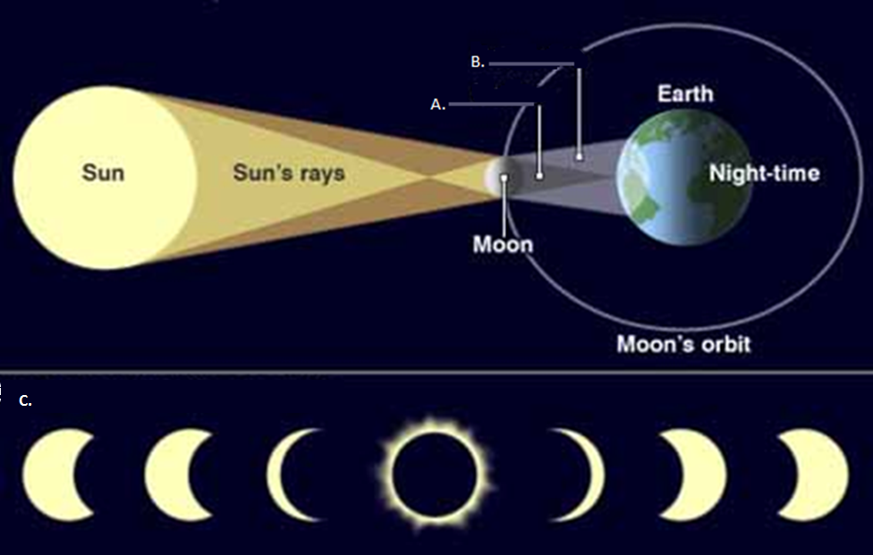
DIAGRAM 1:
The next 6 questions refer to this image.

Slide 4
MORE INFORMATION
Diameter of the Moon = 3 475 km
Diameter of the Earth = 12 756 km
Diameter of the Sun = 1 391 000 km
Circumference of the Sun = 4 366 813 km
Volume of the Sun is 1.4 x 10²⁷ m³
Volume of the Earth = 1.1 x 10²¹ m³
Volume of the Moon = 2.2 x 10¹⁹ m³

Slide 5
QUESTION 1
This diagram shows ____
    The entire solar system
    An eclipse
    A comet passing the Earth
    The daily relationship between the Earth, Moon and Sun

Slide 6
QUESTION 2
What type of eclipse does this diagram show?
        Lunar Eclipse
        Transit Eclipse
        Solar Eclipse
        Galaxy Eclipse

Slide 7
QUESTION 3
The sequence, C on Diagram 1, relates to the larger diagram. It shows _______ as seen from the Earth.
        A dark spot on the Sun
        The transition of the Moon across the Sun
        The phases of the Moon
        The phases of the Sun

Slide 8
QUESTION 4
The full shadow cast by the Moon onto the Earth in the diagram (A) is called____
        The Shadow
        The Umbra
        The Penumbra
        The Full Point

Slide 9
QUESTION 5
The partial shadow cast by the Moon onto the Earth in the diagram (B) is called.
        The Secondary Shadow
        The Umbra
        The Penumbra
        The Partial Point

Slide 10
QUESTION 6
South Africa's MeerKAT telescope is an SKA 'pathfinder' telescope. How many dish-shaped antennas will it consist of?
        64
        74
        46
        47

Slide 11
QUESTION 7
The third closest star to Earth after the Sun is at a distance of approximately 4,37 light years. If 1 light year = 9,46 x 10¹²km, how far is it in kilometres?
      2.16 x 10¹²
      4.62 x 10¹⁰
      5.09 x 10¹²
      4.13 x 10¹³

Slide 12
QUESTION 8
If the Earth has a radius of 6378 kilometres, what will its circumference be in kilometres?
NB: C = 2 π r , π = 3.14
        4.01 x 10⁴
        4.001 x 10⁵
        4.001 x 10⁶
        40.1 x 10⁷

Slide 13
QUESTION 9
The brightest star in the sky, Sirius, is/was __
    closest to the Earth
    whiter and hotter than the Sun
    blue and hot
    discovered by Robert Innes in 1915

Slide 14
QUESTION 10
During total lunar eclipse ______
The Sun is behind Earth, so the Sun's light casts Earth's shadow on the Moon.
Moon is between the Earth & the Sun
The Sun is between the Earth & Moon
The Earth is behind the Sun so that sunlight hits the Moon directly

Slide 15
QUESTION 11
What is a loose collection of ice, dust and small rocky particles, typically with a long, narrow orbit called?
      Comet
      Asteroid
      Meteor
      Meteorite

Slide 16
QUESTION 12
What gives Mars its reddish colour?
A. Sunlight
B. Iron Oxide
C. Glass
D. Water

Slide 17
QUESTION 13
Who developed the three laws describing the motion of planets?
A. Tycho Brahe
B. Albert Einstein
C. Johannes Kepler
D. Daniel Young

Slide 18
QUESTION 14
Albert Einstein is most famous for his theory of __
        A. Relationships
        B. Archaeology
        C. Philosophy
        D. Relativity

Slide 19
QUESTION 15
For a solar eclipse to occur, ____
A. the Sun must be directly between Earth and the
Moon
B. the Moon must be directly between Earth and the Sun
C. the Moon must be directly behind Earth
D. Earth must be directly between the Sun and the
Moon

Slide 20
QUESTION 16
In 1993, the European communications satellite Olympus was hit by a ____ and the mission had to be cancelled.
A. Meteor
B. Meteorite
C. Meteoroid
D. Constellation

Slide 21
QUESTION 17
Jupiter's Great Red Spot is a giant ___
        A. Storm
        B. Crater
        C. Ocean
        D. Volcano

Slide 22
QUESTION 18
What do we call the part of the Sun that is most easily seen during a total solar eclipse?
      A. Solar wind
      B. Heliosphere
      C. Corona
      D. Hemisphere

Slide 23
QUESTION 19
Where do we find most asteroids in our solar system?
      A. Between Mars and Earth
      B. Between Mars and Jupiter
      C. Between Mars and Saturn
      D. Between Mars and Pluto

Slide 24
QUESTION 20
Which type of telescope never has problems seeing through Earth's atmosphere and can use mirrors or lenses to enlarge an object.
A. Earth-based telescope
B. Reflecting telescope
C. Refracting telescope
D. Space-based telescope

Slide 25
QUESTION 21
The brightest star in the night sky is Sirius. What is the name of the second brightest star?
A. Arcturus
        B. Canopus
        C. Rigel
        D. Betelgeuse

Slide 26
QUESTION 22
The Southern Cross, Crux, is the smallest constellation whilst ____ is the largest in the sky.
        Cancer
        Scorpio
        Hydra
        Orion

Slide 27
QUESTION 23
One of the principal objectives of the New Horizons Mission was to give a better understanding of Pluto and its moons.
          True
          False

Slide 28
QUESTION 24
When was New Horizons launched into space?
        14 June 2016
        19 January 2006
        14 July 2015
        28 February 2007

Slide 29
QUESTION 25
When did this spacecraft, New Horizons, fly by Pluto?
        14 June 2016
        19 January 2006
        14 July 2015
        28 February 2007

Slide 30
QUESTION 26
When did this spacecraft, New Horizons, fly by Jupiter?
        14 June 2016
        19 January 2006
        14 July 2015
        28 February 2007

Slide 31
QUESTION 27
What is name of the brightest star in the constellation of Orion?
        Betelgeuse
        Antares
        Rigel
        Bellatrix

Slide 32
QUESTION 28
Which star’s 100th anniversary, since its discovery, was celebrated in 2015?
        The Sun
        Alpha Centauri
        Sirius
        Proxima Centauri

Slide 33
QUESTION 29
Who made the discovery of this star and from where was the discovery made?
Caroline Shoemaker; USA Observatory
Robert Innes; SAASTA Johannesburg Observatory
Johannes Kepler; Germany Observatory
Sivuyile Manxoyi; South African Astronomical Observatory

Slide 34
QUESTION 30
There was a solar eclipse on 21 August 2017 but sadly it was not visible in South Africa at all.
            True
            False

Slide 35
THANK YOU
FOR PARTICIPATING

