Slide 1
WELCOME
to the
SAASTA
AstroQuiz 2017
ROUND 3

Slide 2
RULES
You only have 60 seconds to answer the questions.
You are allowed to discuss amongst yourselves.
Calculators may be used if needed.
No internet is to be used, therefore the use of cellphones is also prohibited.
The judge’s decision is final.

Slide 3
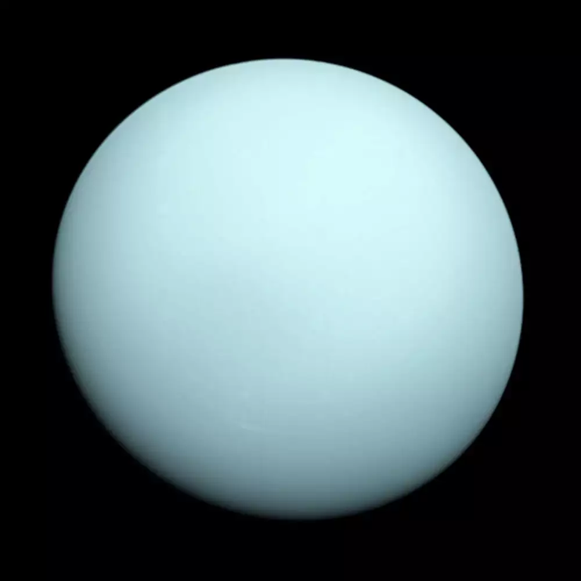
PLEASE PRINT THIS PICTURE WITH COLOUR AND LET THE LEARNERS USE IT TO ANSWER QUESTIONS 1 – 10.

Slide 4
QUESTION 1
The planet represented in Picture 1 has more than one moon.
        True
        False

Slide 5
QUESTION 2
This planet, represented in Picture 1, is found beyond the Kuiper belt.
      True
      False

Slide 6
QUESTION 3
This planet, in Picture 1, is ______
    Bigger than Saturn and smaller than Neptune
    Bigger than Earth and smaller than Neptune
    Bigger than Earth and smaller than Saturn
    Bigger than Jupiter but smaller than Earth

Slide 7
QUESTION 4
Whereas Earth is tilted at an angle of 23,5 degrees from its vertical, this planet is tilted by approximately ______ from its vertical.
        45 degrees
        25,3 degrees
        54 degrees
        90 degrees

Slide 8
QUESTION 5
The most abundant gases in this planet’s are _____
      Hydrogen and Methane
      Hydrogen and Helium
      Hydrogen and Lithium
      Hydrogen and Oxygen

Slide 9
QUESTION 6
One of the moons on this planet is approximately half the size of the Earth’s moon.
        True
        False

Slide 10
QUESTION 7
The largest moons on this planet in Picture 1 are named after characters in the play “A midsummer Night’s dream”.
        True
        False

Slide 11
QUESTION 8
Each half of the planet on Picture 1 experiences a 21-year-long winter.
        True
        False

Slide 12
QUESTION 9
While the other planets look like spinning tops as they make their journey around the Sun, this planet is flipped on its side when it goes around the Sun.
        True
        False

Slide 13
QUESTION 10
What is the name of this planet represented in Picture 1?
        Mars
        Earth
        Uranus
        Neptune

Slide 14
QUESTION 11
How many hexagonal elements are there in SALT’s primary mirror?
        91
        57
        80
        100

Slide 15
QUESTION 12
What is the name of the Australian Square Kilometre Array forerunner?
      Pathfinder
      Explorer
      MeerKAT
      KAT-7

Slide 16
QUESTION 13
What does the acronym for the space probe COBE stand for?
        Cosmic Background Explorer
        Centre Of Basic Exploration
        Centre Of Basic Education
        Cosmic Behind Explorers

Slide 17
QUESTION 14
What is the heaviest element to form in the core of a massive star?
        Iron
        Gold
        Diamond
        Steel

Slide 18
QUESTION 15
What is the average Earth – Moon distance?
        384 000 km
        364 000 km
        384 000 m
        364 000 m

Slide 19
QUESTION 16
Which amongst the following is the smallest dwarf planet?
            Ceres
            Eris
            Pluto
            Makemake

Slide 20
QUESTION 17
How many days are there between the waxing quarter and waning quarter Moon?
          29
          30
          14
          31

Slide 21
QUESTION 18
What is the largest moon in the solar system?
          Ganymede
          Titan
          Europa
          Io

Slide 22
QUESTION 19
What planet in the solar system has its axis of rotation almost in the plane of the ecliptic?
            Saturn
            Jupiter
            Mars
            Uranus

Slide 23
QUESTION 20
What is the name of the South African Square Kilometre Array forerunner?
            Pathfinder
            Explorer
            MeerKAT
            SKA

Slide 24
QUESTION 21
How long does it take the reflected sunlight to reach us from the Earth’s Moon?
        8 minutes
        1 hour
        1¼ seconds
        1 minute

Slide 25
QUESTION 22
Why do we not have lunar or solar eclipses every month? It is because ______
  We cannot see the Moon everyday of the month
  The Earth's orbit around the Sun is not in the same plane as the Moon's orbit around the Earth
  Of the speed at which the Moon is orbiting the Earth
  Of the speed at which the Earth is orbiting the Moon

Slide 26
QUESTION 23
Around which planet in the solar system can we find the smallest moon?
        Saturn
        Jupiter
        Mars
        Uranus

Slide 27
QUESTION 24
Around which planet would you find the largest moon in the solar system?
        Saturn
        Jupiter
        Mars
        Uranus

Slide 28
QUESTION 25
On which planet in the solar system would you find the largest volcano?
        Saturn
        Jupiter
        Mars
        Uranus

Slide 29
QUESTION 26
The second nearest star to us after the Sun is Proxima Centauri. What is the third nearest star to us?
          Barnard’s Star
          Sirius
          Antares
          Alpha Centauri

Slide 30
QUESTION 27
Sputnik 1 was the first artificial satellite ever to be launched into space. When did this happen?
      4 October 1957
      12 April 1961
      4 December 1957
      16 June 1963

Slide 31
QUESTION 28
What was the name of the first US satellite to be launched into space?
      Explorer 1
      SUNSAT
      Sputnik 1
      Salyut 1

Slide 32
QUESTION 29
What was the name of the first South African satellite to be launched into space?
      Explorer 1
      SUNSAT
      Sputnik 1
      Salyut 1

Slide 33
QUESTION 30
Of the 5 officially recognised dwarf planets in our solar system, Pluto is the largest, followed by _
        Eris, Haumea, Makemake, Ceres
        Eris, Makemake, Haumea, Ceres,
        Eris, Haumea, Makemake, Ceres
        Eris, Ceres, Makemake, Haumea,

