Slide 1
WELCOME
to the
SAASTA
AstroQuizTM 2015
NATIONAL FINALS

Slide 2
RULES OF THE QUIZ
The audience must be silent throughout the quiz and NOT whisper to anyone.
No resource material can be taken into the quiz venue.
Teams have up to 1 minute to discuss each answer and must reveal their answers immediately when the signal is given that the time is up.
The scores will be calculated and given after THE FIRST ten questions ONLY and overall winners will be announced at the Awards function in the evening.
The audience will get a chance to win prizes!
A tie-break will be settled on a “sudden death” basis, involving tied teams only (i.e. as soon as a team falls behind on correct answers, it is knocked out).

Slide 3
QUESTION 1
The Milky Way Galaxy is best observed from the Southern than Northern hemisphere.
      True
      False

Slide 4
QUESTION 2
Radio Astronomy in Southern Africa started in 1961 with the construction of a facility now known as Hartebeesthoek Radio Astronomy Observatory.
      True
      False

Slide 5
QUESTION 3
The core of the Square Kilometer Array will be situated in the Karoo in the North West province.
        True
        False

Slide 6
QUESTION 4
How many terrestrial planets have natural satellites?
        A. Five
        B. One
        C. Four
        D. Two

Slide 7
QUESTION 5
Temperatures around the equator are on average higher than any other on planet Earth because _____
The equator is much closer to the Sun
The angle of incidence is close to zero degrees from the vertical
The equator cuts the Earth at the centre
The equator absorbs and retains the heat from the
Sun

Slide 8
QUESTION 6
The biggest asteroid known is ___
      Vesta
      Icarus
      Ceres
      Eros

Slide 9
QUESTION 7
Which of the following describes Vostok 1 best?
      It is supposed to reach Jupiter and send pictures back to Earth
      It is the first manned space mission
      It is the first spacecraft to take animals
      It is the first spacecraft to disintegrate before reaching space

Slide 10
QUESTION 8
Heliocentric means around ____
        Jupiter
        The Sun
        Neptune
        Earth

Slide 11
QUESTION 9
Triton, Neptune’s moon, has an ocean made of liquid. Which liquid is this?
        Water
        Oxygen
        Nitrogen
        Hydrogen

Slide 12
QUESTION 10
The greatest distance of a plane from the Sun is called its__________
        Aphelion
        Perihelion
        Helix
        eccentricity

Slide 13
QUESTION 11
Planet Jupiter has a mass that is ____
Equal to the combined masses of Earth & Mars
Equal to the combined masses of Saturn and Pluto
Equal to the combined masses of Saturn, Neptune & Uranus
Greater than the combined masses of all planets

Slide 14
QUESTION 12
Which of the planets below have no moons at all?
      Venus & Mercury
      Mercury & Neptune
      Uranus & Neptune
      Venus & Uranus

Slide 15
QUESTION 13
When the Earth is furthest from the sun, what season is it in the Northern hemisphere?
        Summer
        Winter
        Autumn
        Spring

Slide 16
QUESTION 14
On which day of the year does the summer solstice occur?
        June 21
        Dec 21
        June 1
        Dec 01

Slide 17
QUESTION 15
Which of the following is true about Orion? It is__
      One of the brighter stars in the sky
      A constellation
      The moon of one of the planets
      An asteroid

Slide 18
QUESTION 16
A telescope’s magnification refers to its ability to ___
      Enlarge an image
      Bring an image closer
      Collect light
      Refract light

Slide 19
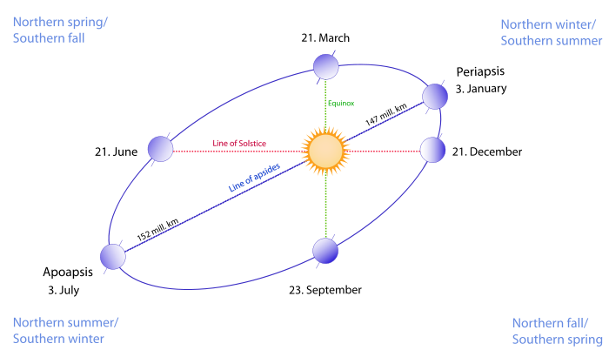
THE FOLLOWING DIAGRAM SHOWS THE EARTH AT THE DIFFERENT POSITIONS AROUND THE SUN.
USE THE DIAGRAM TO ANSWER QUESTIONS 17 - 23.

Slide 20
QUESTION 17
Which motion does Path 2 in the diagram represent?
      Earth’s rotation
      the Sun’s rotation
      Earth’s revolution
      the Sun’s revolution

Slide 21
QUESTION 18
What kind of an eclipse is represented in the diagram?
      Lunar
      Solar

Slide 22
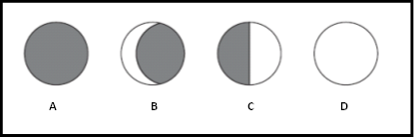
QUESTION 19
Which Moon phase will usually be seen from Earth when the Moon is in the position above?

Slide 23
QUESTION 20
At which position of the Earth will the Southern hemisphere experience summer?
        1
        2
        3
        4

Slide 24
QUESTION 21
At which positions of the Earth will there be an equinox?
        1 & 2
        2 & 3
        3 & 4
        2 & 4

Slide 25
QUESTION 22
Approximately around which date will the Northern hemisphere get its summer solstice?
      21 March
      21 June
      21 Dec
      23 Sept

Slide 26
QUESTION 23
During an equinox, neither the Southern nor Northern pole is tilted towards the Sun.
        True
        False

Slide 27
QUESTION 24
If your weight on Earth is 50 kg, what would your approximate weight be on the Sun and on the Moon?
  A. 119 kg (Sun) and 115 kg (Moon)
  B. 873 kg (Sun) and 39 kg (Moon)
  C. 1000 kg (Sun) and 960 kg (Moon)
  D. 1353 kg (Sun) and 8 kg (Moon)

Slide 28
QUESTION 25
The diameter of the Earth is 12 756 km. If a soccer field is 100 m long, how many soccer fields will fit in the Earth’s diameter?
          127,560
          12,75600
          12756000
          12756

Slide 29
QUESTION 26
At 1 000 kilometres per hour, how long would it take a spacecraft to go from Venus to the Sun? (distance between the Sun and Venus =108 x 10⁶ km)
    4,7 years
    107 748 hours
    15,2 days
    21,1 hours

Slide 30
QUESTION 27
The three nearest stars to the Sun are _
    Spica, Betelgeuse, Rigel
    Aldebaran, Acturus, Polaris
    Proxima Centauri, Alpha Centauri, Bernard star
    Proxima Centauri, Rigel and Spica

Slide 31
QUESTION 28
The concept “habitable zone” of a star refers to___
The area around a star where the temperature does not change
The area around a star where there is a possibility of finding liquid water
The area around a star where human beings are found
The area around a star where other small stars can be found

Slide 32
QUESTION 29
If the Earth has a radius of 6378 kilometres, what will its circumference (c) be in kilometres?
NB: C = 2 π r , π = 3.14
            40053,84
            4,0053 x 105
            4,0053 x 106
            40,0053 x 107

Slide 33
QUESTION 30
Apart from the Moon, which other place in our solar system has been visited by human beings?
        Venus
        Saturn
        None
        Mars

Slide 34
THANK YOU
FOR PARTICIPATING

Slide 35
SUDDEN DEATH
TIE BREAKERS

Slide 36
PLEASE REMEMBER:
The first school to get the answer correct is the winner.
GOOD LUCK!

Slide 37
QUESTION 1
The tilt of the Earth’s spin axis causes ______
        the seasons
        day and night.
        the ice on its poles.
        it to sustain life.

Slide 38
QUESTION 2
The brightest star in the sky, Sirius, is/was____
    Closest to the Earth
    Whiter and hotter than the Sun
    Blue and hot
    Discovered by Robert Innes in 1915

Slide 39
QUESTION 3
Which of the following is the
most accurate about seasons?
  Seasons occur because the Sun goes around the Earth and the Moon around the Earth
  Seasons occur because the Earth goes around the Sun
  Seasons occur because the Earth goes around the Sun and its axis is tilted at 23.5⁰ to the plane of its orbit
  Seasons occur because the Earth’s orbit brings it nearer and further away from the Sun

Slide 40
QUESTION 4
Which one of the following is true?
A galaxy is made of a few collection of stars held together by common gravity
None of the stars in a galaxy have common gravity
Galaxies contain stars only
A galaxy is a collection of many stars, gas and dust which are held together by gravity

Slide 41
QUESTION 5
Planets in the solar system shine by ____
        Nuclear fusion in their cores
        Refracting sunlight
        Reflecting sunlight
        b and c above

Slide 42
THANK YOU
FOR PARTICIPATING
ALL THE BEST!

